Slide 1
Programming Fundamentals
Lecture 13

Slide 2
Objectives
Initialization of Objects
  By assigning constant values in class
  By using Constructors
Types of Constructors
  Default constructor
  Overloaded constructor
  Default copy constructor
Destructor

Slide 3
Evaluate Yourself First
Write a code by using the concepts of OOP to illustrate the condition of a vehicle.
You need to take the values of total fuel consumed (float), total distance travelled (int) and the price (double) of three vehicles (Bike, Car and Jeep) and then display the values

Slide 4
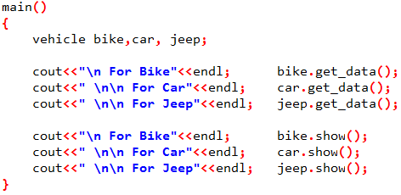
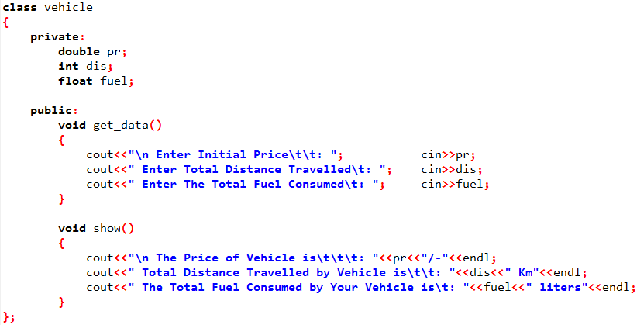
Example Code

Slide 5
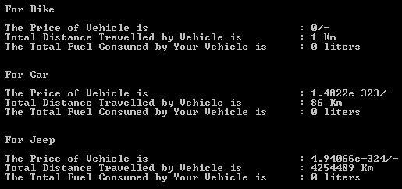
Question
What will happen if we call the show() method directly without using the get_data() method in previous example?
The garbage will be displayed, see the output screen

Slide 6
Initialization of Objects
We need to initialize the objects from some default values in order to get desired values
By initialization of object, we mean to initialize the attributes of the object
There are different ways to initialize an object
  By assigning constant values in class
  By using Constructors

Slide 7
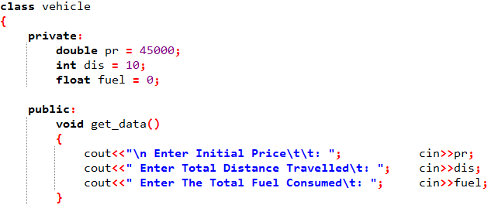
Initialization by Using Assignment Operator
In this method the constant values are assigned within the class
While declaring the attributes of an object the assignment operator is used to declare the initial values of attributes

Slide 8
Initialization by Using Assignment Operator
Advantage
  Can be used to initialize the selected attributes
  Can initialize several objects with same values
Disadvantage
  This feature is only available in C++11 or gnu++11 or higher
  Only single value can be used to initialize all the objects
  Will reserve the space in memory regardless of object’s creation

Slide 9
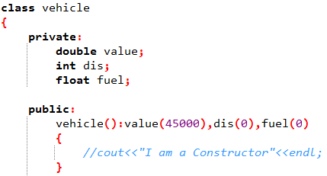
Initialization with the Use of Constructor
Constructor
  A constructor is a member function of a class which is automatically called upon the creation of an object
Properties
  Same name as class
  No return type
  Initializer List

Slide 10
Practice Problem 1
Create a class named “vehicle” with price, distance covered and fuel consumed as its static attributes.
Create two methods in the class to get the input from user and display them
Your class must have the capability of initializing the objects upon their creation

Slide 11
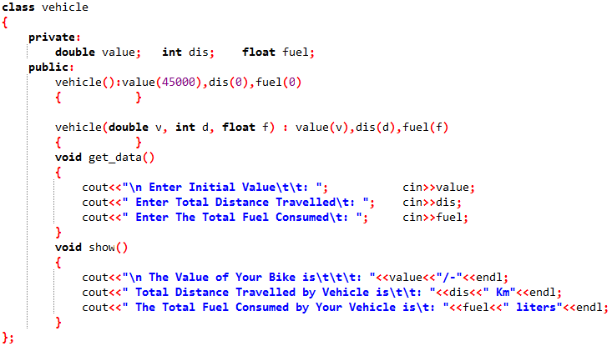
Overloaded Constructor (1/2)
Identify the Constructor
What are the Overloaded Functions?

Slide 12
Overloaded Constructor (2/2)
Normally a Constructor with zero arguments is called the default constructor
And if we declare another constructor within the same class having non zero arguments then we say that constructor is overloaded

Slide 13
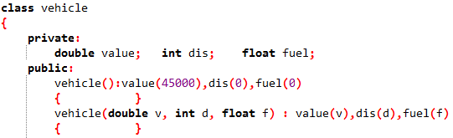
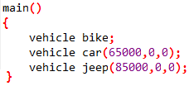
Which Constructor is Used?
If we have more than one constructors in a class then upon the creation of an object which constructor will be called automatically?
The constructor matching with the number of arguments of object will be called
In above example, constructor 1 will be called upon the creation of bike and constructor 2 will be called on the creation of Jeep and Car

Slide 14
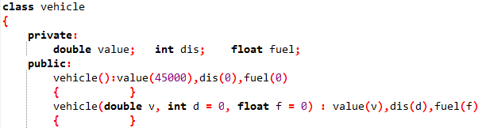
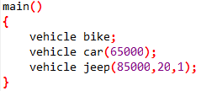
Default Values in Constructor
Like functions, we can declare the default values of different parameters in the constructor
Similar to functions, if the parameter is passed upon the creation of object then the passed value is used otherwise the default values will be used

Slide 15
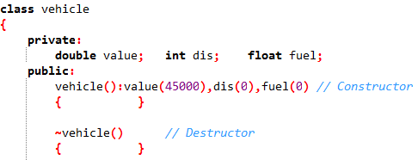
Destructor
A constructor is called automatically when an object is created
A Destructor is called automatically when an object is destroyed
A destructor has the same name as the constructor but is preceded by a tilde and don’t contains the list of initializers

Slide 16
The Default Copy Constructor
A no-argument constructor can initialize data members to constant values
And a multi-argument constructor can initialize data members to values passed as arguments
Another way to initialize an object is to initialize it with another object of the same type
You don’t need to create a special constructor for this; one is already built into all classes
And this constructor is called the default copy constructor

